Slide 1
iMDE: international Market-Driven Engineering
Lecture 5: Innovation Climate and Innovation Examples

Slide 2
Lectures
The course will take you from “how to generate innovations”, though “the writing of Business Plans, and understanding Product development and Production” to the “how to sell and market a product”.
Lecture 1: Introduction
Lecture 2: Innovation-Inspiration
Lecture 3: Innovation-Ideation
Lecture 4: Innovation-Implementation
Lecture 5: Innovation-Innovation climate and Examples
Lecture 6: Product Development, sourcing and Production
Lecture 7: Business plan
Lecture 8: Marketing and Sales
Lecture 9: Final presentation (all day)
Lecture 10: End of course

Slide 3
Agenda
09.15-10.00 Innovation climate in China (Jun Jin)
10.00-10.15 break
10.15-11.00 Innovation climate in Sweden (Jun and Anders)
11.00-11.15 break
11.15-12.00 Examples from production (Qinmin)

Slide 4
Image of China
What do you know about China?
What represent China?

Slide 5
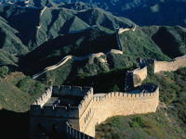
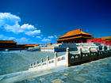
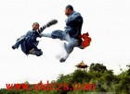
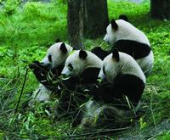
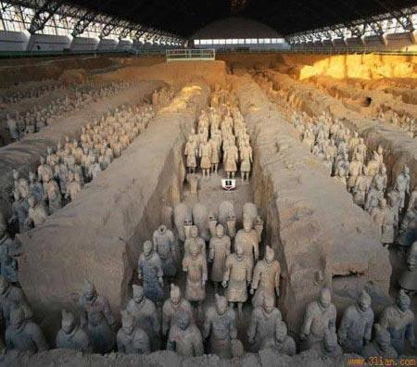
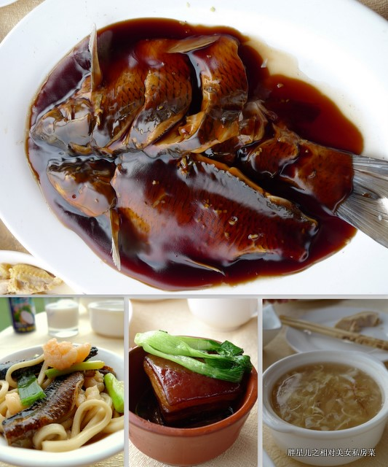

Slide 6
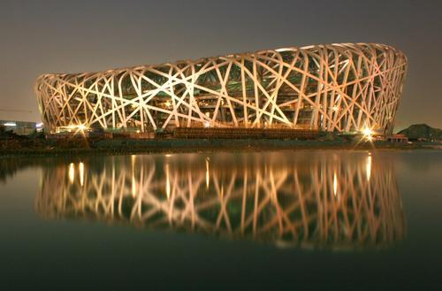
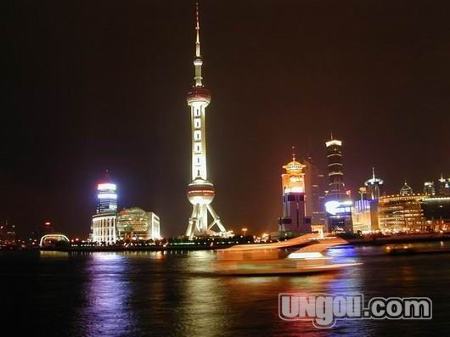
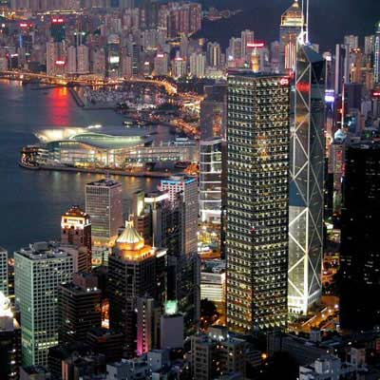
How many Chinese cities do you know?
© Jun Jin, SOM-ZJU

Slide 7
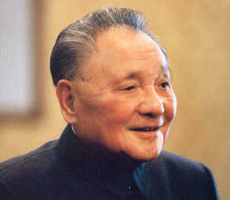
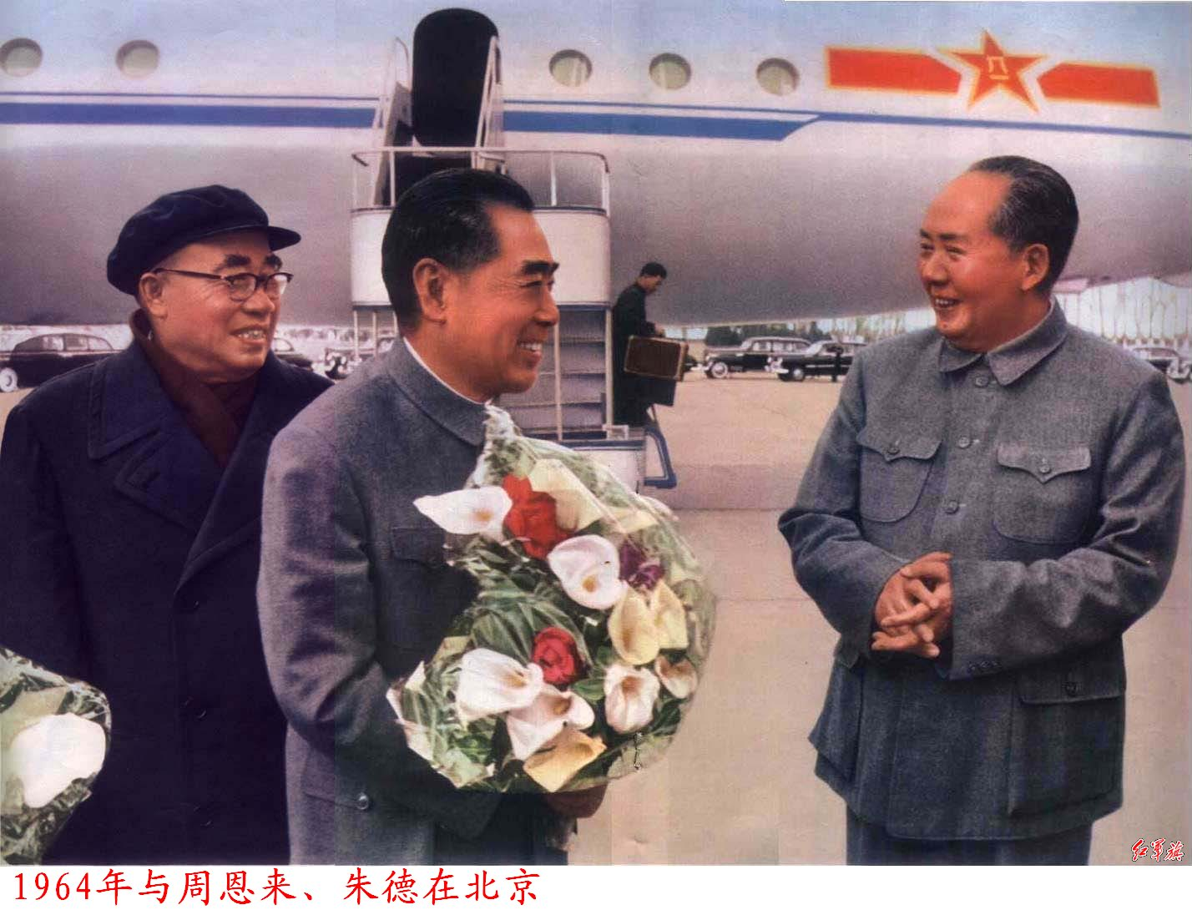
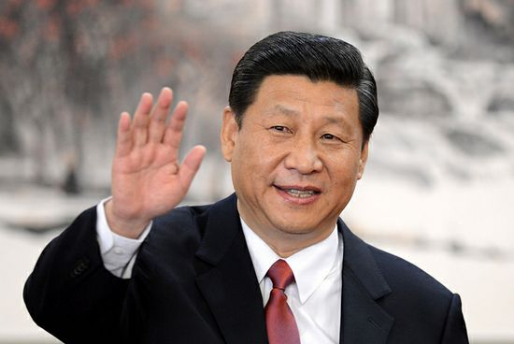
Do you know these Chinese leaders?
© Jun Jin, SOM-ZJU

Slide 8
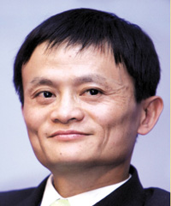
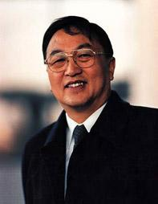
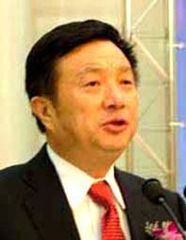
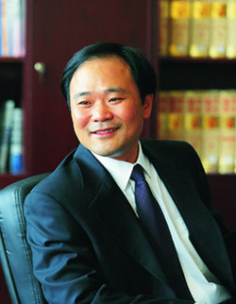
Do you know these Chinese Businessmen?
© Jun Jin, SOM-ZJU

Slide 9
Chinese new innovation policies
In early 2006, China’s new median and long term S&T plan (2006-2020)
Objective: making China an innovation-based country in 2020
Increasing R&D spending to 2.5 percent of GDP
Increasing the contribution of S&T to the economic growth
Reducing over-dependency on foreign technology
Stepping up the output of publications and patents in major fields
Approach: promoting indigenous innovation;
Acquisition, assimilation, and innovation;
Integrative innovation
Original innovation
© Jun Jin, SOM-ZJU

Slide 10
Priority Areas
Applied research based on the societal needs:
Energy, water resources, environmental protection, health, agriculture, manufacturing, service, and etc ;
Mega Projects:
Semiconductor manufacturing, broadband wireless mobile communication, nuclear power water pollution treatment, power, AIDS and Hepatitis, aircraft manufacturing, space exploration and etc.
Frontier Technologies:
Bio-tech, IT, new materials, new energy, space…
Important basic research
In broad areas and interdisciplinary areas.
© Jun Jin, CPA-ZJU

Slide 11
Some issues: Chinese philosophy and culture
© Jun Jin, SOM-ZJU

Slide 12
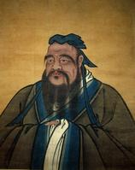
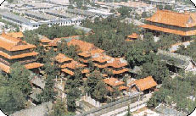
Confucianism
The core of traditional culture
Emphasize: regulation, moral, and personality
People-oriented
Influence over the history, social structure and the people of China and Asia
The role of Confucius: especially on education
Impact on the Chinese intellect
e.g. Studying without thinking leads to confusion; thinking without studying leads to laziness
Temple of Confucius
© Jun Jin, SOM-ZJU

Slide 13
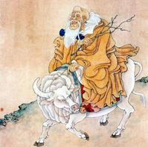
Laos: Tao Te Ching
Work: Tao Te Ching
About the nature rules, and methodologies to do things
Some theories:
Wu Wei: non action
Without intention, It manifests all things
The tangible is manifested from the intangible
Religion: Taoism
© Jun Jin, SOM-ZJU

Slide 14
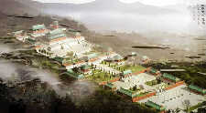
Laos: Taoism
About 2000 years
Emphasize the link between human and nature
Peaceful
Ancient Architectural Complex in Wudangshan Mountain
© Jun Jin, SOM-ZJU

Slide 15
Yin and Yang
Moon and Sun
Female and male
Dark and bright
Food
Harmony, balance
Usage example: mostly, danger is not on the opposite of safety, it hides in the safety who drowned?
© Jun Jin, SOM-ZJU

Slide 16
Arts of War
Sun Tzu:
an ancient Chinese military strategist at the Spring and Autumn Period (around 2500 years ago)
36 strategies: widely used in Chinese and Japanese business
No. 7, Creating something out of nothing
The role of media
Rumor
No.31, using beauty to corrupt the enemy
No. 36, running away as the best choice
Keep life and leave as early as possible
© Jun Jin, SOM-ZJU

Slide 17
New Development Strategies in China
Mao’s theories
Rural area → urban → rural
The household contract responsibility system in rural area 1978
1984 to Cities, individual
Morden agriculture
Eastern → western & North-eastern
MNCs new strategies in China: moving to the 2nd and 3rd tiers of cities
© Jun Jin, SOM-ZJU

Slide 18
Agenda
09.15-10.00 Innovation climate in China (Jun Jin)
10.00-10.15 break
10.15-11.00 Innovation climate in Sweden (Jun and Anders)
11.00-11.15 break
11.15-12.00 Examples from production (Qinmin)

Slide 19
©2012, andreas.larsson@design.lth.se
http://www.ge.com/innovationbarometer/
Notes:
The Milken Institute prepared the Innovation Scorecard for GE. The 22 markets surveyed were ranked on seven key indicators based on the top 100 countries in the World Economic Forum's Global Competitiveness Report 2011-2012. They were then placed in a quartile (leading, above average, below average, or lagging) based on their performance. To view a full country profile, scroll over a country and click.
University-Industry Collaboration in R&DMeasures the extent to which businesses and universities collaborate on research. Data is collected through survey responses. Source: The Global Competitiveness Report 2011-2012 (World Economic Forum)
Venture Capital DealsThe number of venture capital deals performed in a country. Source: The Global Source: The Global Innovation Index 2011 (INSEAD)
Gross Expenditures on Research & Development (GERD)The total expenditure on research and development performed within the country by all sources during the year, calculated as a percentage of GDP. Source: The Global Source: The Global Innovation Index 2011 (INSEAD)
High-Tech ExportsProducts with high R&D intensity, such as computers and pharmaceuticals, are included in this category. This indicator is calculated as a percentage of all manufactured exports. The most recent year for which the majority of countries had data was 2008. Source: World Development Indicators 2008 (World Bank)
Utility PatentsMost patents issued by the U.S. Patent and Trademark Office (USPTO) are utility patents, or "patents for invention." This indicator captures any patent issued by the USPTO that "pertains to the invention of a new and useful process, machine, manufacture, or composition of matter." The number is given per million inhabitants. Source: The Global Competitiveness Report 2011-2012 (World Economic Forum)
STEM EducationThis indicator measures the quality of the science, technology, engineering and math education (STEM) in a given country. Source: The Global Competitiveness Report 2011-2012 (World Economic Forum)
Business EnvironmentThis indicator is an index that ranks each country’s business environment on a number of factors such as time required to start a business, ease of acquiring electricity, accessing credit, paying taxes, cross-border trading, and more. Source: Doing Business 2012 (a co-publication of the World Bank and the International Finance Corporation)

Slide 20
©2013, Jun Jin, SOM-ZJU
http://www.ge.com/innovationbarometer/

Slide 21
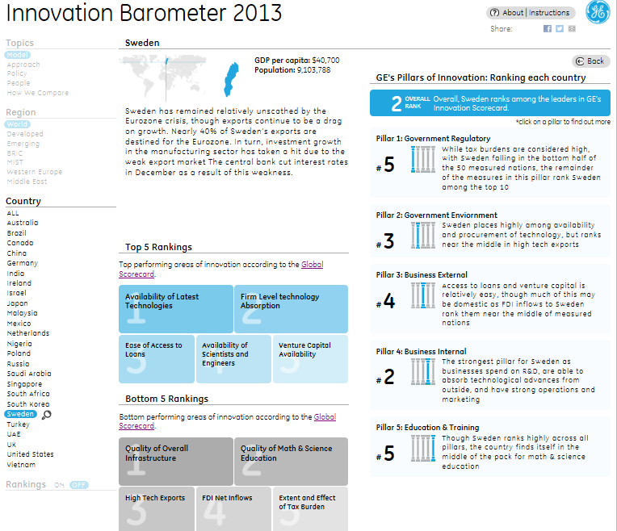
©2013, Jun Jin, SOM-ZJU
http://www.ge.com/innovationbarometer/

Slide 22
CHINA
©2013, Jun Jin, SOM-ZJU
http://www.ge.com/innovationbarometer/

Slide 23
SWEDEN
©2013, Jun Jin, SOM-ZJU
http://www.ge.com/innovationbarometer/

Slide 24
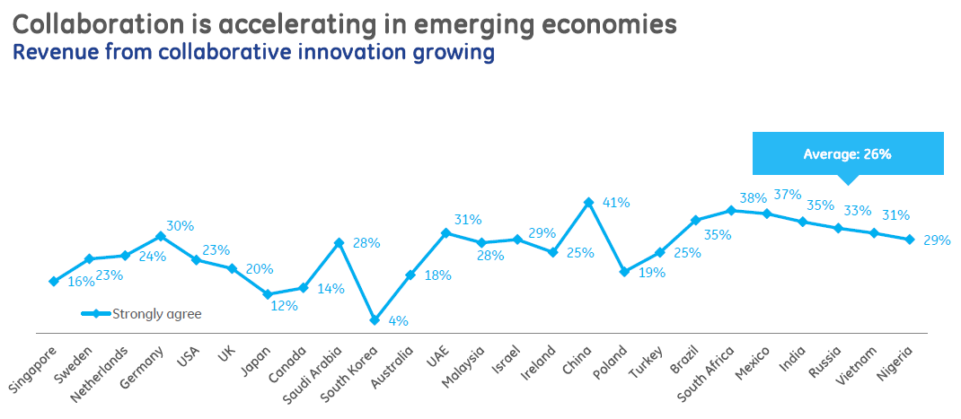
©2013, Jun Jin, SOM-ZJU
http://www.ge.com/innovationbarometer/

Slide 25
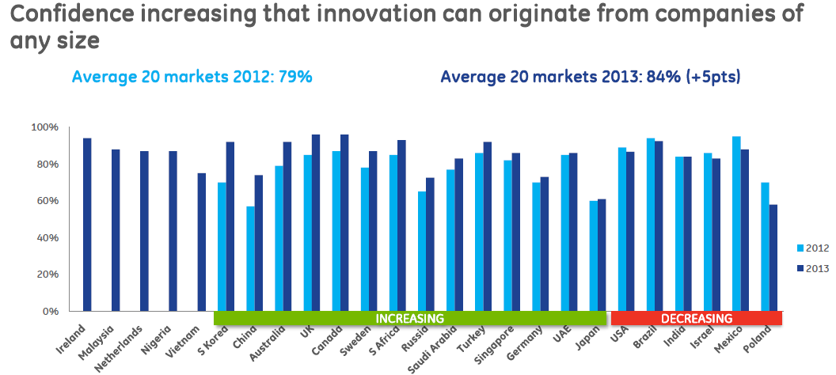
©2013, Jun Jin, SOM-ZJU
http://www.ge.com/innovationbarometer/

Slide 26
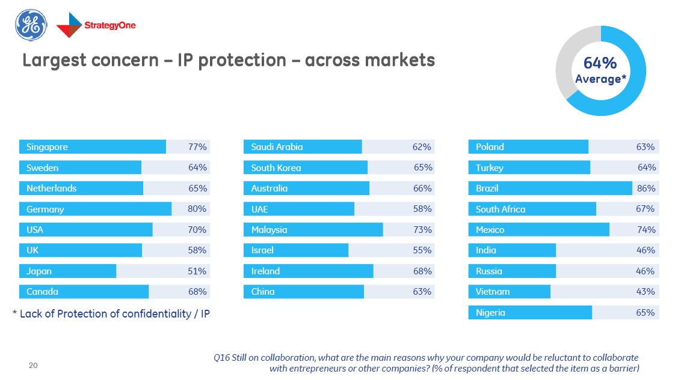
©2013, Jun Jin, SOM-ZJU
http://www.ge.com/innovationbarometer/

Slide 27
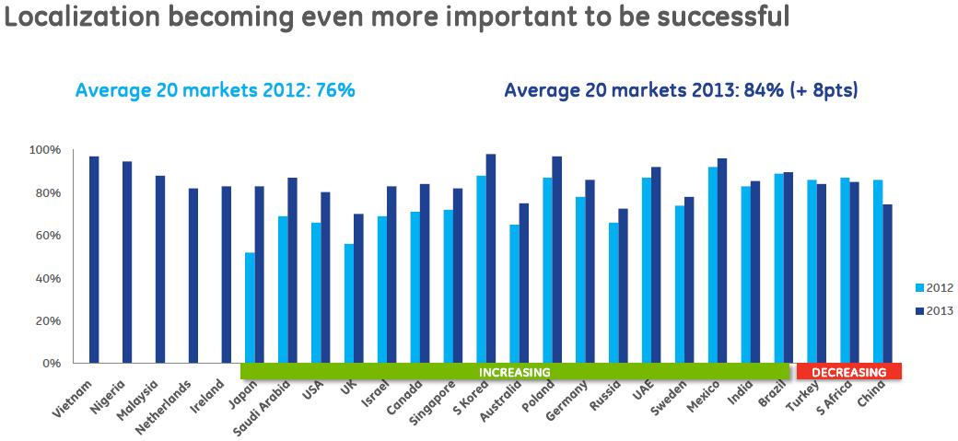
©2013, Jun Jin, SOM-ZJU
http://www.ge.com/innovationbarometer/

Slide 28
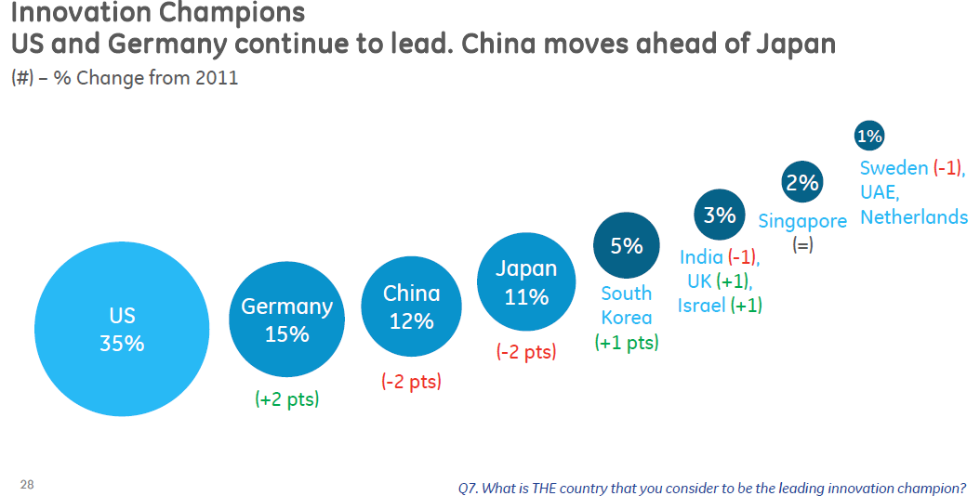
©2013, Jun Jin, SOM-ZJU
http://www.ge.com/innovationbarometer/

Slide 29
SWEDEN national innovation strategy *meet global social challenges * continue to strengthen the competitiveness of Sweden-based companies in international markets * provide good quality welfare and social services
©2012, andreas.larsson@design.lth.se
Notes:
Sweden is one of the few European countries that doesn’t have an outlined national strategy for innovation.
Even though Sweden scores highly on various input indicators (such as R&D), the Swedish system still struggles to convert this into economic gain. The goal is for the Government to decide on an innovation strategy in early autumn 2012, expressed in a policy document aimed at 2020 to promote the climate for innovation long term.
Motivation:
* meet global social challenges (climate, environmental and security issues, which also offer business opportunities)* continue to strengthen the competitiveness of Sweden-based companies in international markets (and ensure the international attractiveness of Swedish environments for future skills supply, exports and employment)* provide good quality welfare and social services (since fewer must be able to provide for increasingly more as the population on an average is growing older)

Slide 30
EUROPEAN UNION THE INNOVATION UNION * Improved access to finance * Innovation-friendly rules and regulations * Accelerated interoperable standard-setting * Cheaper patenting * Innovation supported by the public sector * Innovation Partnerships * Easier participation in EU research/innovation programmes
©2012, andreas.larsson@design.lth.se
Notes:
We need to do much better at turning our research into new and better services and products if we are to remain competitive on the global marketplace and improve the quality of life in Europe.
We are facing a situation of 'innovation emergency'. Europe is spending 0.8% of GDP less than the US and 1.5% less than Japan every year on Research & Development (R&D). Thousand of our best researchers and innovators have moved to countries where conditions are more favourable. Although the EU market is the largest in the world, it remains fragmented and not enough innovation-friendly. And other countries like China and South Korea are catching up fast.
The Innovation Union is a crucial investment for our future. For example, achieving our target of investing 3% of EU GDP on R&D by 2020 could create 3.7 million jobs and increase annual GDP by €795 billion by 2025.The Innovation Union means:* Improved access to finance* Innovation-friendly rules and regulations* Accelerated interoperable standard-setting* Cheaper patenting* Innovation supported by the public sector* Innovation Partnerships to give EU businesses a competitive edge* Easier participation in EU research and innovation programmes

Slide 31
EUROPEAN UNION horizon 2020 * 2014-2020, €80 billion budget * Strengthen the EU’s position in science with a dedicated budget of € 24 598 million. * Strengthen industrial leadership in innovation € 17 938 million. * Provide € 31 748 million to help address major concerns shared by all Europeans (climate change, developing sustainable transport and mobility, making renewable energy more affordable, ensuring food safety and security, or coping with the challenge of an ageing population.)
©2012, andreas.larsson@design.lth.se
Notes:
Horizon 2020 is the financial instrument implementing the Innovation Union, a Europe 2020 flagship initiative aimed at securing Europe's global competitiveness. Running from 2014 to 2020 with an €80 billion budget, the EU’s new programme for research and innovation is part of the drive to create new growth and jobs in Europe.
Horizon 2020 provides major simplification through a single set of rules. It will combine all research and innovation funding currently provided through the Framework Programmes for Research and Technical Development, the innovation related activities of the Competitiveness and Innovation Framework Programme (CIP) and the European Institute of Innovation and Technology (EIT).
The proposed support for research and innovation under Horizon 2020 will:* Strengthen the EU’s position in science with a dedicated budget of € 24 598 million. This will provide a boost to top-level research in Europe, including an increase in funding of 77% for the very successful European Research Council (ERC).* Strengthen industrial leadership in innovation € 17 938 million. This includes major investment in key technologies, greater access to capital and support for SMEs.* Provide € 31 748 million to help address major concerns shared by all Europeans such as climate change, developing sustainable transport and mobility, making renewable energy more affordable, ensuring food safety and security, or coping with the challenge of an ageing population.

Slide 32
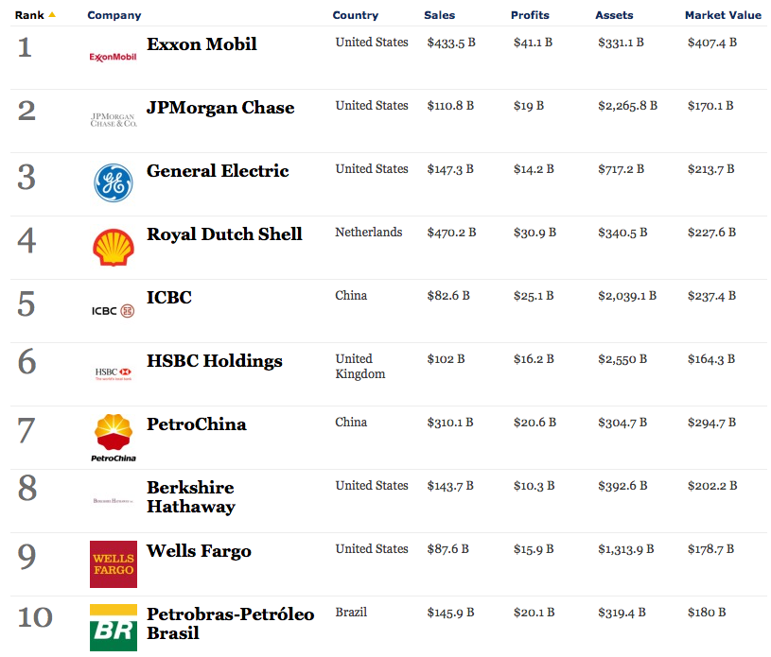
©2012, andreas.larsson@design.lth.se
http://www.forbes.com/global2000/
Notes:
The Forbes Global 2000 are the biggest, most powerful listed companies in the world. These firms have the top composite scores based on their rankings for sales, profits, assets and market value.
WORLD

Slide 33
Rank | Company |  | Country | Sales | Profits | Assets | Market Value
1 |  | ICBC | China | $134.8 B | $37.8 B | $2,813.5 B | $237.3 B
2 |  | China Construction Bank | China | $113.1 B | $30.6 B | $2,241 B | $202 B
3 |  | JPMorgan Chase | United States | $108.2 B | $21.3 B | $2,359.1 B | $191.4 B
4 |  | General Electric | United States | $147.4 B | $13.6 B | $685.3 B | $243.7 B
5 |  | Exxon Mobil | United States | $420.7 B | $44.9 B | $333.8 B | $400.4 B
6 |  | HSBC Holdings | United Kingdom | $104.9 B | $14.3 B | $2,684.1 B | $201.3 B
7 |  | Royal Dutch Shell | Netherlands | $467.2 B | $26.6 B | $360.3 B | $213.1 B
8 |  | Agricultural Bank of China | China | $103 B | $23 B | $2,124.2 B | $150.8 B
9 |  | PetroChina | China | $308.9 B | $18.3 B | $347.8 B | $261.2 B
9 |  | Berkshire Hathaway | United States | $162.5 B | $14.8 B | $427.5 B | $252.8 B
©2013, Jun Jin SOM-ZJU
http://www.forbes.com/global2000/
Notes:
The Forbes Global 2000 are the biggest, most powerful listed companies in the world. These firms have the top composite scores based on their rankings for sales, profits, assets and market value.
WORLD

Slide 34
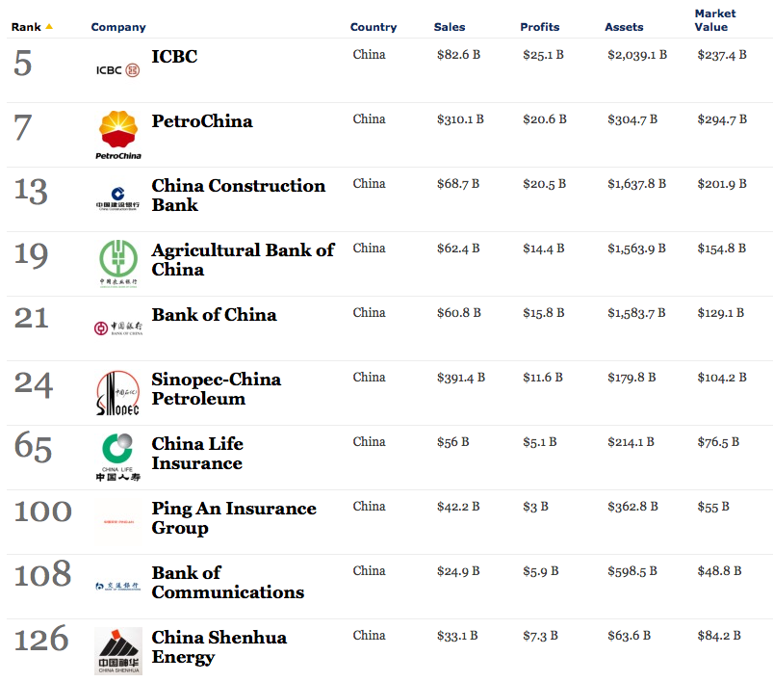
©2012, andreas.larsson@design.lth.se
http://www.forbes.com/global2000/
Notes:
CHINA

Slide 35
Rank | Company |  | Country | Sales | Profits | Assets | Market Value
1 |  | ICBC | China | $134.8 B | $37.8 B | $2,813.5 B | $237.3 B
2 |  | China Construction Bank | China | $113.1 B | $30.6 B | $2,241 B | $202 B
8 |  | Agricultural Bank of China | China | $103 B | $23 B | $2,124.2 B | $150.8 B
9 |  | PetroChina | China | $308.9 B | $18.3 B | $347.8 B | $261.2 B
11 |  | Bank of China | China | $98.1 B | $22.1 B | $2,033.8 B | $131.7 B
26 |  | Sinopec-China Petroleum | China | $411.7 B | $10.1 B | $200 B | $106.9 B
54 |  | Bank of Communications | China | $43.5 B | $9.4 B | $846.4 B | $56.7 B
83 |  | Ping An Insurance Group | China | $51.1 B | $3.2 B | $456.2 B | $57 B
101 |  | China Merchants Bank | China | $28.4 B | $7.3 B | $547 B | $44.1 B
106 |  | China Life Insurance | China | $63.2 B | $1.8 B | $304.6 B | $79.9 B
©2013, Jun Jin SOM-ZJU
http://www.forbes.com/global2000/
Notes:
The Forbes Global 2000 are the biggest, most powerful listed companies in the world. These firms have the top composite scores based on their rankings for sales, profits, assets and market value.
WORLD

Slide 36
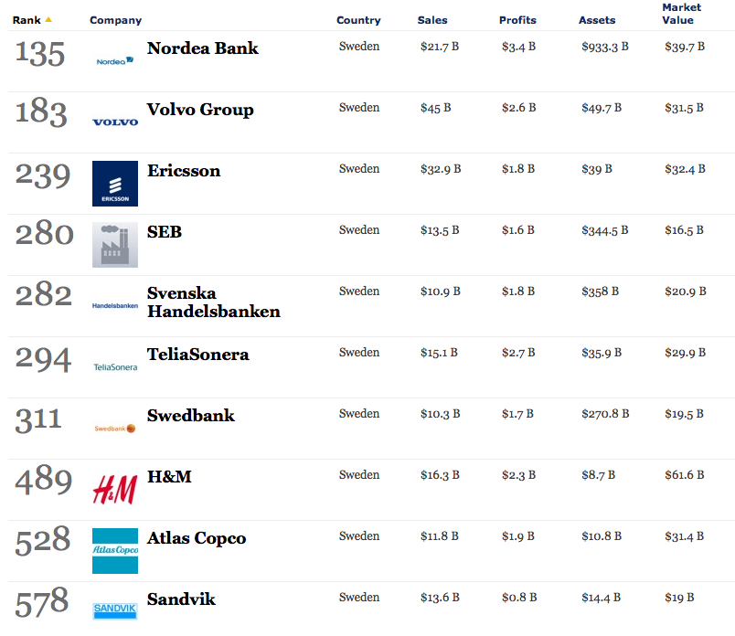
©2012, andreas.larsson@design.lth.se
http://www.forbes.com/global2000/
Notes:
SWEDEN

Slide 37
Rank | Company |  | Country | Sales | Profits | Assets | Market Value
118 |  | Nordea Bank | Sweden | $23.2 B | $4.2 B | $892.6 B | $47.1 B
210 |  | Volvo Group | Sweden | $46.7 B | $1.7 B | $50.4 B | $31.9 B
243 |  | SEB | Sweden | $14.4 B | $1.8 B | $376.8 B | $23.5 B
247 |  | Svenska Handelsbanken | Sweden | $11.5 B | $2.2 B | $367 B | $28.2 B
265 |  | Swedbank | Sweden | $10.9 B | $2.2 B | $283.8 B | $27.4 B
286 |  | TeliaSonera | Sweden | $16.1 B | $3.1 B | $38.1 B | $31 B
292 |  | Ericsson | Sweden | $35 B | $0.9 B | $40.4 B | $44.1 B
481 |  | Atlas Copco | Sweden | $13.4 B | $2.1 B | $12.5 B | $35.2 B
486 |  | H&M | Sweden | $18.1 B | $2.5 B | $8.8 B | $59.8 B
505 |  | Sandvik | Sweden | $15.2 B | $1.2 B | $16 B | $20.5 B
©2013, Jun Jin SOM-ZJU
http://www.forbes.com/global2000/
Notes:
The Forbes Global 2000 are the biggest, most powerful listed companies in the world. These firms have the top composite scores based on their rankings for sales, profits, assets and market value.
WORLD

Slide 38
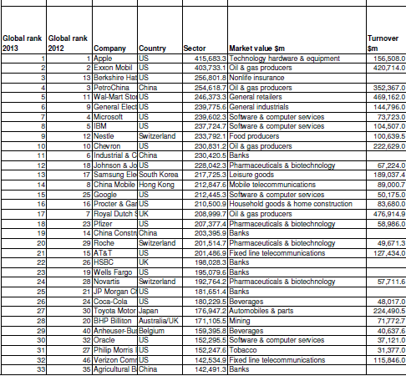
© 2012, Jun Jin, SOM-ZJU
http://www.ft.com/intl/companies/ft500
Notes:
SWEDEN

Slide 39
Agenda
09.15-10.00 Innovation climate in China (JunJin)
10.00-10.15 break
10.15-11.00 Innovation climate in Sweden (Anders)
11.00-11.15 break
11.15-12.00 Examples from production (Qinmin)

Slide 40
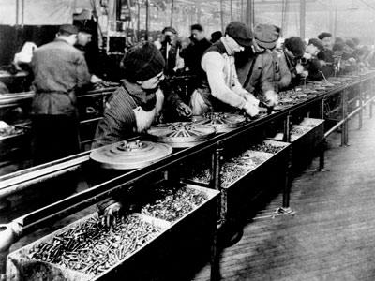
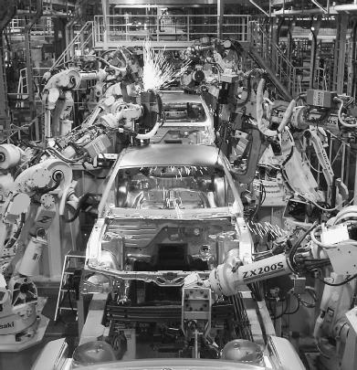
Production
From: manual production
To: automated production
A journey of 100+ years
A journey filled with
many innovations

Slide 41
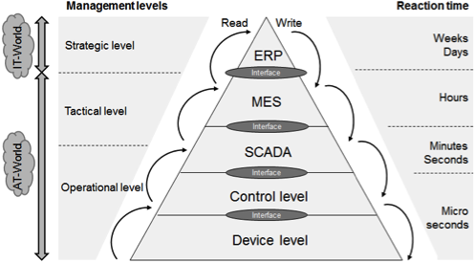
Production

Slide 42
About SUPCON
SUPCON Group Co., Ltd. (SUPCON in short)
Founded in 1993
A leading high-tech enterprise in China with focus on total solutions for innovative industrial control and information technologies.
Both hardware and software products.
Customers: Steel, Chemical, Petrochemical, pulp and paper, Power, etc.
Competitors: Siemens, ABB,
Rockwell Automation, Invensys,
GE Fanuc, Allan&Bradley, etc.

Slide 43
About SUPCON
According to ARC Advisory Group's research, significant economic benefits can be obtained by applying process automation. For example, product quality can be increased by 19.2%, productivity by 13.5%, and production by 11.5%.
InPlant (note: Supcon’s solution) provides an integrated solution for process automation industries. The solution integrates process control, optimization, planning, scheduling and management.
More info: www.supcon.com

Slide 44
Visit to Supcon
Date: Thursday September 26th, 2013.
Time: 08:00 – approx.13:00
Transport: Bus, we meet at Yuquan Campus, in front of No. 8 Dorm Building at 08:00.
Schedule:
8:00am: Depart from Yuquan Campus 9:00am: Arrive at Supcon 9:00 – 10:15am: Introduction of the company 10:15 - 10.45 Presentation of the iMDE course for Supcon 10:45 - 11:30am: Discussion and presentation led by its employees 11:30am: Going back home

Slide 45
Visit to Supcon
Date: Thursday September 26th, 2013.
Time: 08:00 – approx.13:00
Transport: Bus, we meet at Yuquan Campus, in front of No. 8 Dorm Building at 08:00.
Preparations:
Group 8: Prepare a presentation (30min) about the iMDE-course in English and Chinese.
Group 6: Prepare 5 questions about History and Start- up of Supcon (English and Chinese).
Group 2: Prepare 5 questions about Supcon and Innovations (English and Chinese).
Everyone to think of general questions

Slide 47
References Innovation Climate in Sweden
Ekvall, Organizational Climate for Creativity and Innovation:
http://tinyurl.com/9da29yp (restricted access)
Isaksen et al, Creating More Innovative Workplaces:
http://tinyurl.com/8dsago2
GE Innovation Barometer:
http://www.ge.com/innovationbarometer/
Forbes Global 2000:
http://www.forbes.com/global2000/
Financial Times 500:
http://www.ft.com/intl/companies/ft500

Slide 48
Agenda
09.15-10.00 Innovation climate in China (JunJin)
10.00-10.15 break
10.15-11.00 Innovation climate in Sweden (Anders)
11.00-11.15 break
11.15-12.00 Examples from production and Company Visit (Qinmin)
** Thank you for your attention **

